Slide 1

Java RMI
Truong-Thanh Le
truongl@ifi.uio.no
September 4, 2025

Slide 2
Java RMI
Local objects can invoke methods in remote objects
Clients can invoke methods on remote objects held at the Servers
Don't use JDK 7 or lower
Server:
Creates remote objects
Clients:
Invokes methods on remote objects

Slide 3
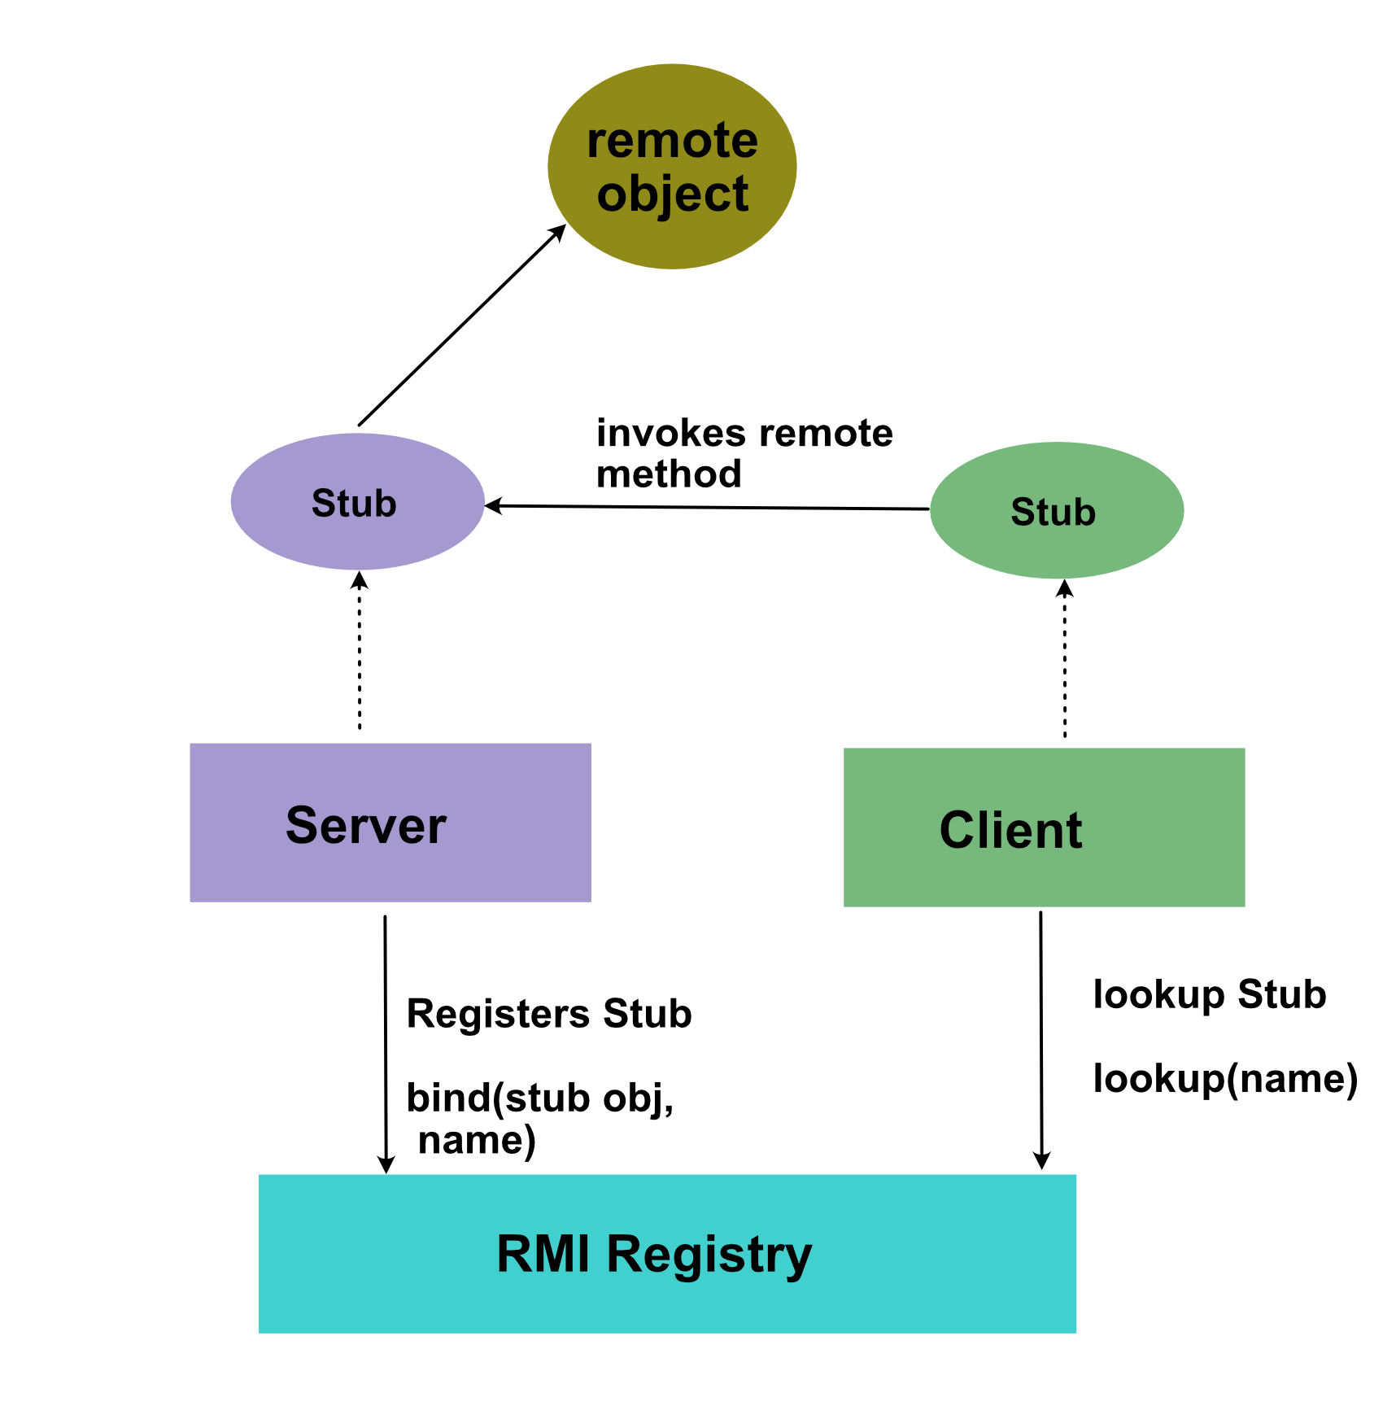
Java RMI
Server:
Implements remote object
Creates stub (referred as skeleton previously)
for the remote object
Registers the stub in the rmiregistry
Client:
Lookups the stub by using the name
Calls the remote method through the client stub
Client stub calls the server stub and waits for the server

Slide 4
RMI Registry
Contains reference to set of remote objects (referred using server stub(skeleton))
LocateRegistry – class is used to access the registry
Methods on LocateRegistry:
https://docs.oracle.com/javase/8/docs/api/java/rmi/registry/LocateRegistry.html
Method | Description
CreateRegistry(int port) | Creates and exports a Registry instance on the local host that accepts requests on the specified port
GetRegistry() | Returns a reference to the the remote object Registry for the local host on the default registry port of 1099.
GetRegistry(int port) | Returns a reference to the the remote object Registry for the local host on the specified port.
GetRegistry(String host) | Returns a reference to the remote object Registry on the specified host on the default registry port of 1099.

Slide 5
Create Project
Requirements:
Java SDK
Maven. Include path to environment path.
Install extension for Maven and Java in VSCode.
Steps: these step is used for VSCode with Maven extension
Press Ctrl+Shift+P
Search “Java” -> “Java: Create new project” -> “Maven” -> ”Create a basic Maven project directly”
Enter group id. E.g. ”com.ass1”
Enter artifact id. E.g. “solution”
Reopen VSCode at new generated folder.

Slide 6
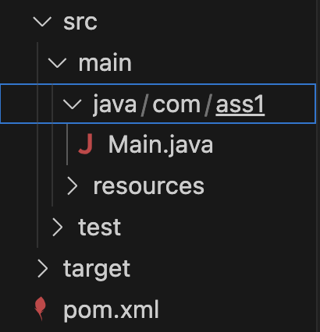
Create Project
Steps: these step is used for VSCode with Maven extension
The structure of the project is like:
Create a folder for Server.
Create an Interface class for RMI: ServerInterface.java
import java.rmi.Remote;
import java.rmi.RemoteException;
public interface ServerInterface extends Remote{
int Add(int num1,int num2) throws RemoteException;
}

Slide 7
Create Project
Steps: these step is used for VSCode with Maven extension.
Create a handling class for RMI: Server.java
import java.rmi.RemoteException;
import java.rmi.registry.LocateRegistry;
import java.rmi.registry.Registry;
import java.rmi.server.UnicastRemoteObject;
import java.rmi.AlreadyBoundException;
public class Server implements ServerInterface{
public int Add(int num1, int num2) {
return num1 + num2;
}
public static void main(String[] args){
try {
Registry registry = LocateRegistry.getRegistry();
Server server = new Server();
ServerInterface serverStub = (ServerInterface) UnicastRemoteObject.exportObject(server, 0);
Registry.bind("server", serverStub);
} catch (RemoteException | AlreadyBoundException e) {
e.printStackTrace();
}
}
}

Slide 8
Create Project
Steps: these step is used for VSCode with Maven extension
Create a folder for Client.
Create a client class for RMI: Client.java
import java.rmi.AlreadyBoundException;
import java.rmi.NotBoundException;
import java.rmi.RemoteException;
import java.rmi.registry.LocateRegistry;
import java.rmi.registry.Registry;
import java.rmi.server.UnicastRemoteObject;
import com.ass1.server.ServerInterface;
public class Client {
public static void main(String[] args) {
try {
Registry registry = LocateRegistry.getRegistry();
ServerInterface server = (ServerInterface) registry.lookup("server");
System.out.println(server.Add(10,20));
} catch (RemoteException | NotBoundException e) {
e.printStackTrace();
}
}
}

Slide 9
Build Project
Steps: these step is used for VSCode with Maven extension
Choose Terminal -> Run Build Task -> Build Workspace
Perform this action every time you modify the source code
Optional: On ”Explore” Window -> Java Project -> Export Jar -> withour Main Class
Start rmiregistry: On terminal:
cd ./target/classes
rmiregistry

Slide 10
Running project with jar file
Steps: these step is used for VSCode with Maven extension
New terminal:
java –cp <name>.jar com.<groupdid>.<folder>.<class>
For example:
Server:
java –cp solution.jar com.ass1.server.Server
Client
java –cp solution.jar com.ass1.client.Client

Slide 11
References
https://docs.oracle.com/javase/tutorial/rmi/index.html
https://www.javatpoint.com/RMI
https://docs.oracle.com/javase/8/docs/api/java/rmi/package-summary.html
https://docs.oracle.com/javase/8/docs/api/java/rmi/registry/package-summary.html
https://docs.oracle.com/javase/8/docs/api/java/rmi/registry/LocateRegistry.html

Slide 12
Thank You

